Slide 1
HOUSE GAME

Slide 2



HOUSE GAME
MUSIC HALL
BARN

Slide 3
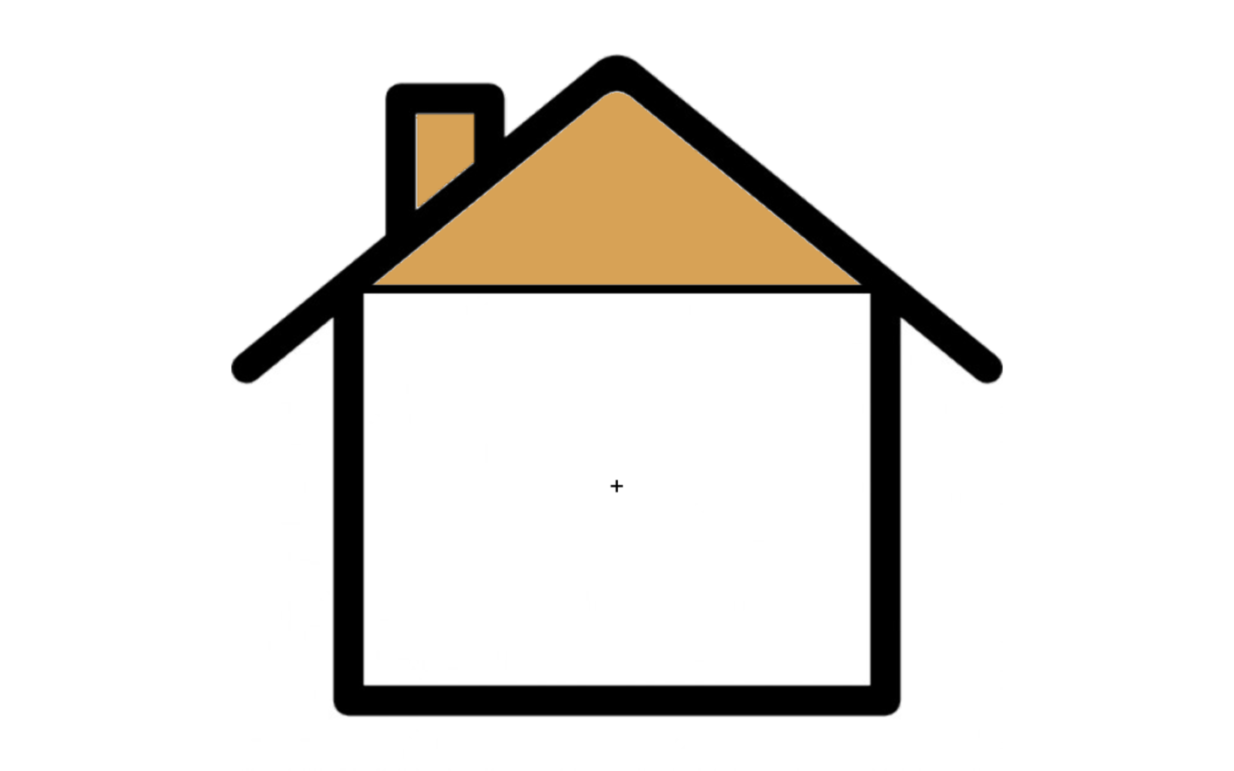

Slide 4



Slide 6
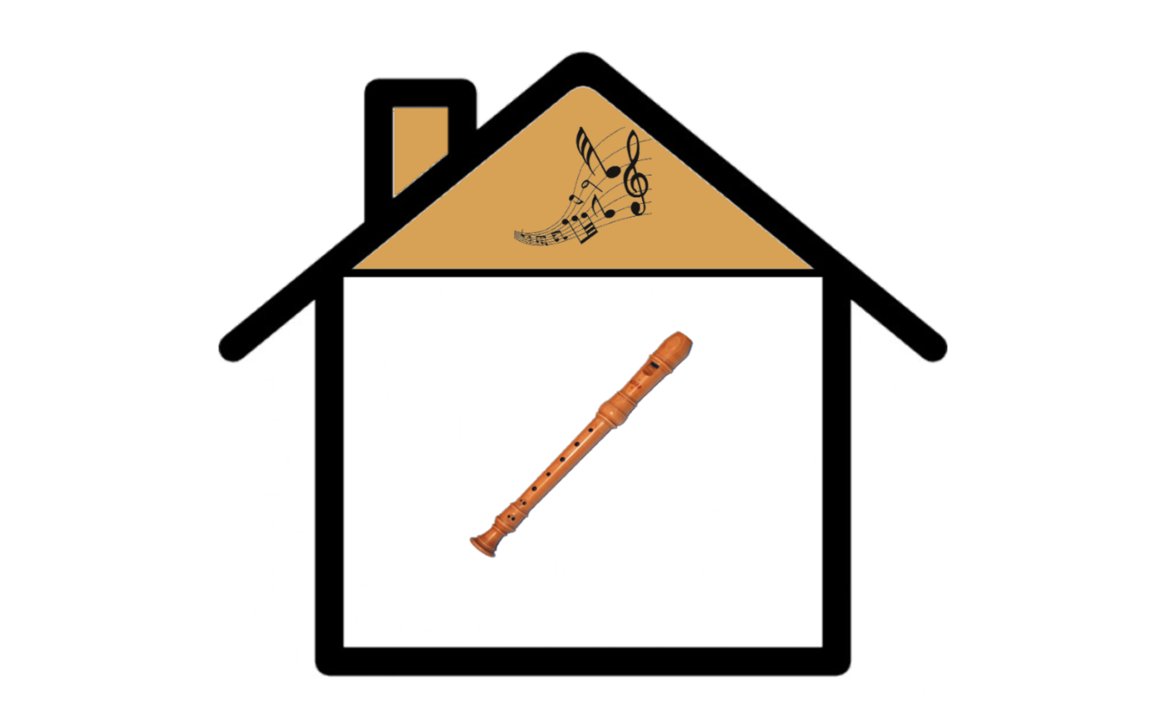

Slide 10
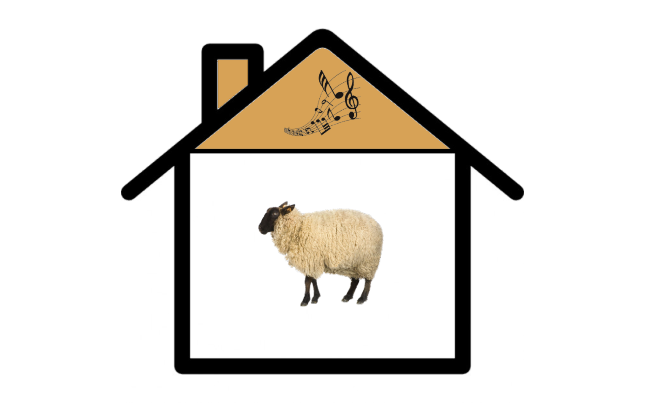

Slide 12
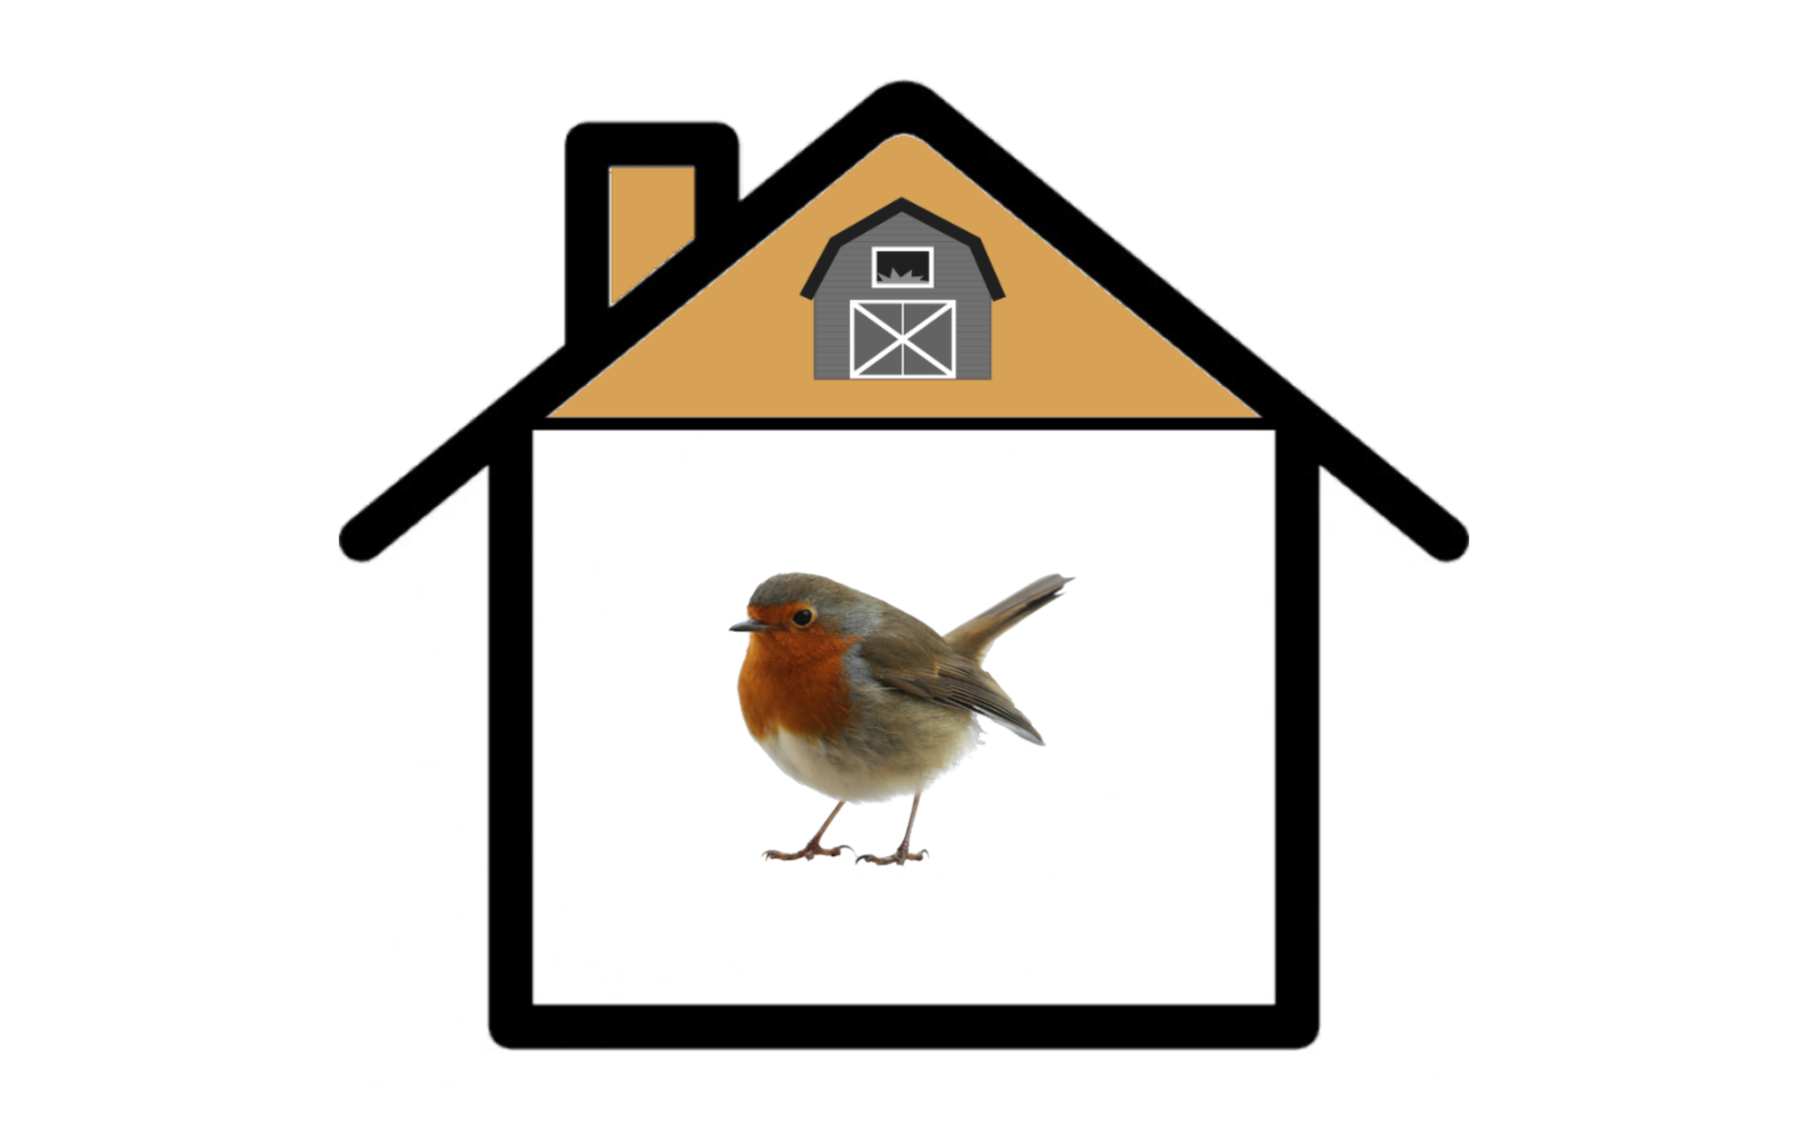

Slide 14


Slide 16
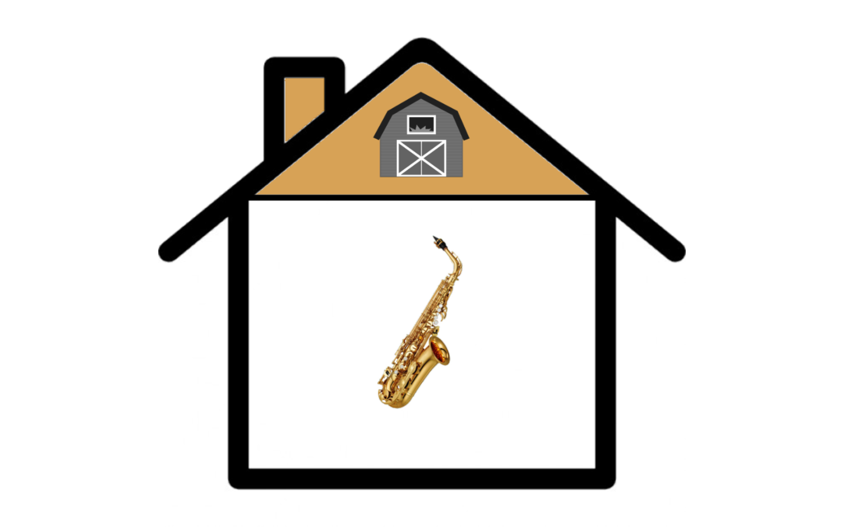

Slide 20
Now Let’s Try It Out…

Slide 22
target

Slide 26
